Slide 1
Diverter Math
Finding Diverts Based on Start and End Points

Slide 2
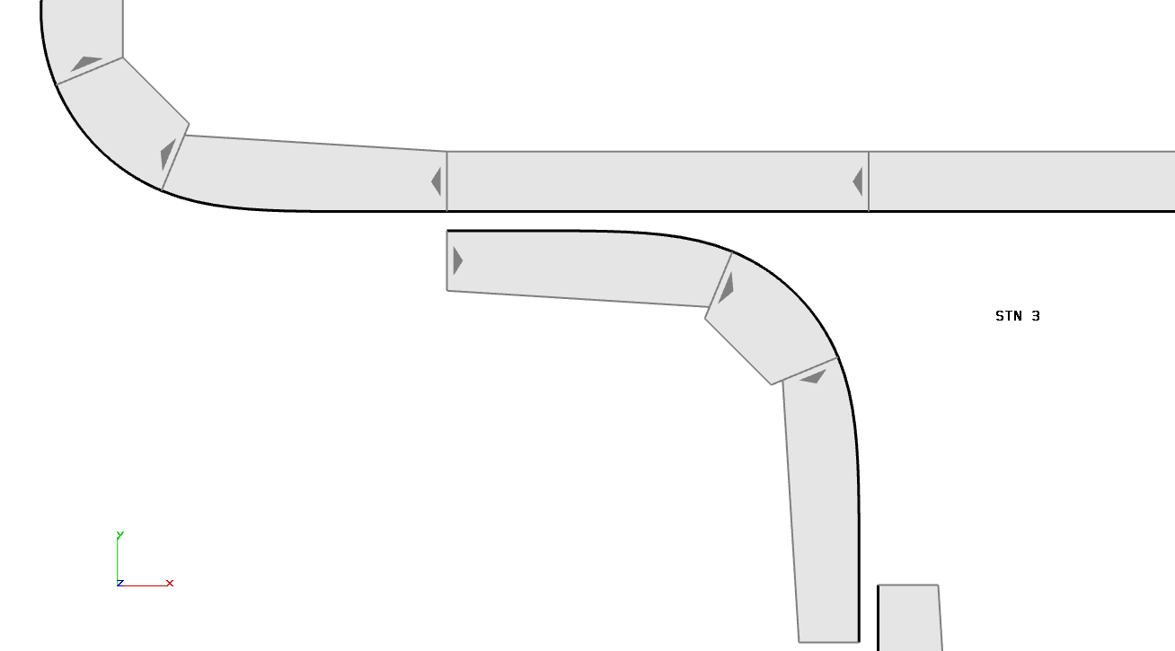
Function Blocks
AsmGetSegment
Iterates through every segment reference
SegGetInfo
Needs a segment reference
Gives information about a segment
Thing of use: Start Point and End Point

Slide 3
Start Point and End Point
-180
22.5
Function Blocks
135
45
Pos (X, Y, and Z)
Orientation (3 angles)
3rd angle is about z which is what we need
Oddity for angles 1 and 2:
Points facing down, left, or up
Angle 1 is 0 and angle 2 is 180
Points facing right and down to but not including straight down
Angle 1 is 0 and angle 2 is -180
Points facing up to but not including straight up and over to the right but not including right
Angle 1 is 180 and angle 2 is 0
67.5
90
-90
45
-45
0

Slide 4
Start Point and End Point
180
202.5
-180
22.5
135
Function Blocks
225
135
45
To make them all in the same useful coordinate system:
Angle 1 is 0 and angle 2 is 180
Transform by taking absolute value
Angle 1 is 0 and angle 2 is -180
Transform by +360
Angle 1 is 180 and angle 2 is 0
Transform by +180
67.5
247.5
90
90
-90
270
45
-45
45
315
0
0

Slide 5
Points
By keeping the points within the segment info structure, I can keep the points connected to each other based on segments they belong to
Builds a sort of web

Slide 6


Concept
Deciding Diverts
Pick a segment
Skip arc segments since they can never be diverts
Iterate through all other segments
Skip arc segments since they can never be diverts
See if a segment’s two points match up with the selected segment’s two points in a way that indicates a divert

Slide 7
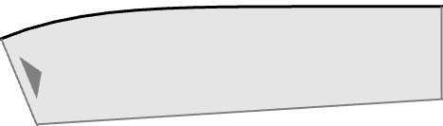
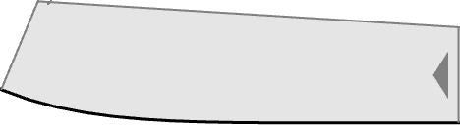
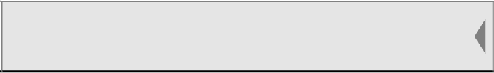
Rules
Deciding Diverts
Must happen along flat sections
Must overlap at least 90mm
Multiple of 15mm (+-0.25mm)
Overlaps must be parallel
Must be separated by 30mm perpendicular to direction of the shuttle motion

Slide 8
Rules
Deciding Diverts
For simplicity, multi segment diverts will be counted as multiple diverts
I.e. A divert is only two segments

Slide 9
Types
Deciding Diverts
There are only 3 segment types that can be used to divert, so there are only 6 unique combinations of two segments
AA – AA
AA – AB
AA – BA
AB – AB
AB – BA
BA – BA

Slide 10
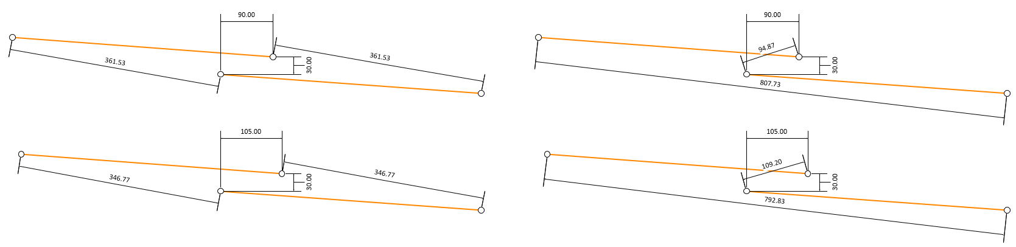
Building a “Map”
Start 2
Y
End 1
End 2
Deciding Diverts
Start 1
X
Take AB – AB divert as an example
Must be between 90-105mm overlap and 30mm apart
Start 2 must be 94.87-109.20mm from Start 1 and 346.77-361.53mm from End 1
End 2 must be 346.77-361.53mm from Start 1 and 792.83-807.73mm from End 1

Slide 11
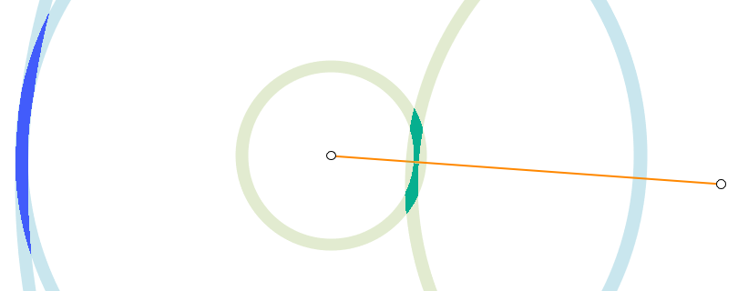
Building a “Map”
Deciding Diverts
Building a map from these rules shows a very small range that a segment can exist in that counts as a divert
Orange represents the segment with Start 1 and End 1
Dark green represents where Start 2 can exist
Dark blue represents where End 2 can exist
Any correctly placed segment that is not a divert can not exist in this range
NOTE: We can also check the orientation of segment 2 to confirm it is 180 degrees from segment 1

Slide 12
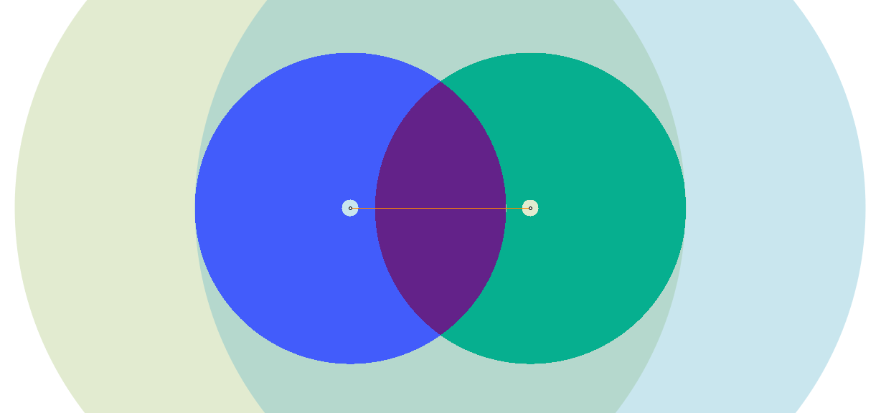
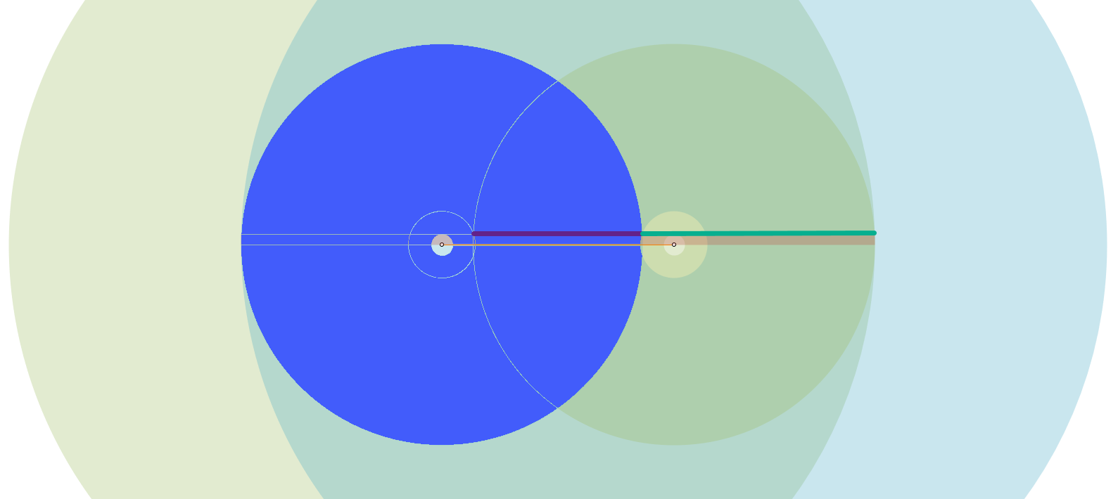
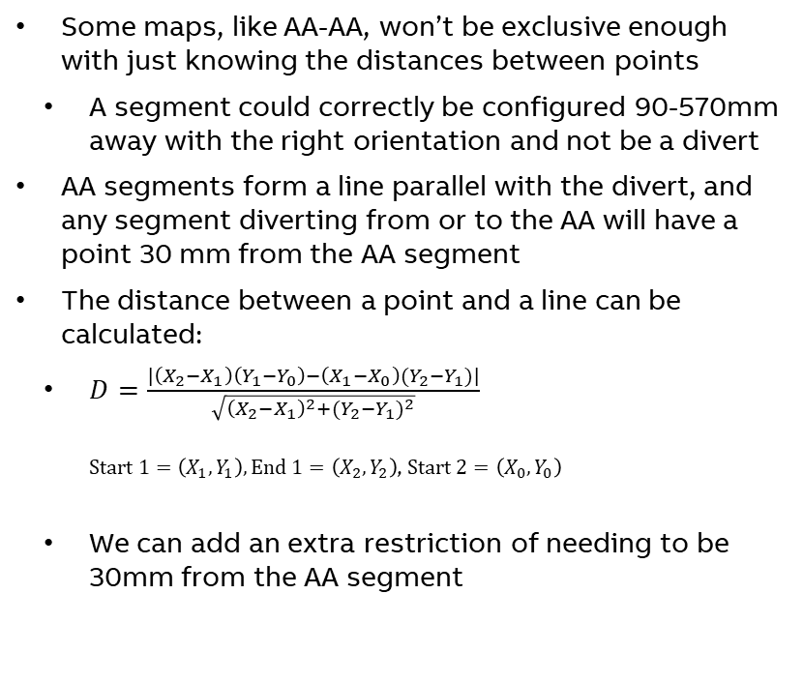
Building a “Map”
End 2
Start 2
Deciding Diverts
Start 1
End 1
Some maps, like AA-AA, won’t be exclusive enough with just knowing the distances between points
A segment could correctly be configured 90-570mm away with the right orientation and not be a divert
AA segments form a line parallel with the divert, and any segment diverting from or to the AA will have a point 30 mm from the AA segment
The distance between a point and a line can be calculated:
$D=\frac{\left|\left(X_{2}−X_{1}\right)\left(Y_{1}−Y_{0}\right)−\left(X_{1}−X_{0}\right)(Y_{2}−Y_{1})\right|}{\sqrt{{\left(X_{2}−X_{1}\right)}^{2}+{(Y_{2}−Y_{1})}^{2}}}$ $Start 1=\left(X_{1},Y_{1}\right),End 1=\left(X_{2},Y_{2}\right)$, $Start 2=\left(X_{0},Y_{0}\right)$
We can add an extra restriction of needing to be 30mm from the AA segment

Slide 13
Results
Maps and Rules

Slide 14
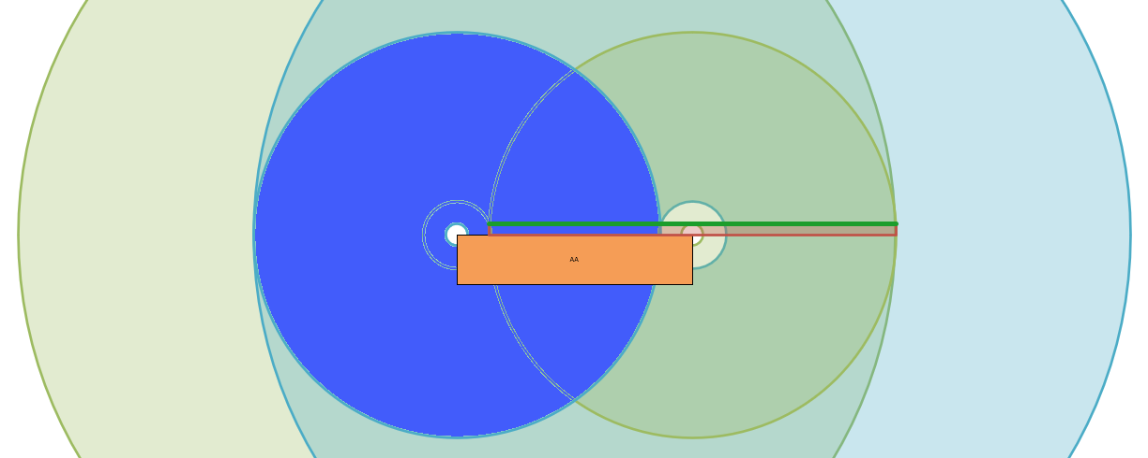
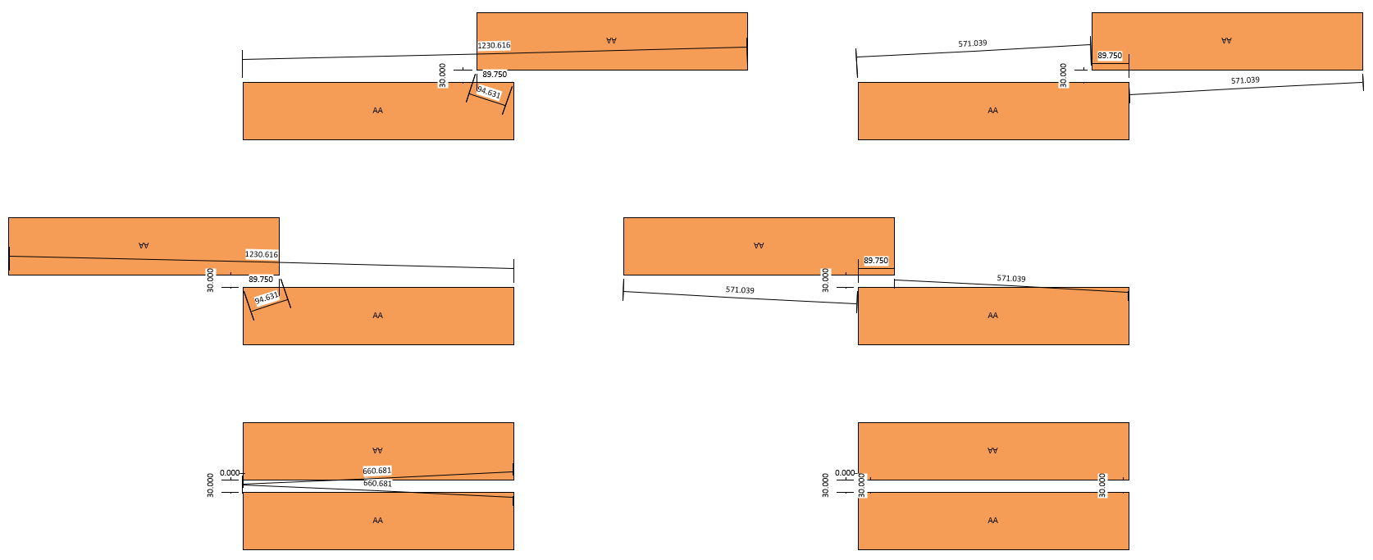
AA-AA Diverts
End 2
Start 2
Y
Maps and Rules
Start 1
End 1
X
Must overlap at least 90mm (+/-0.25mm) and be 30mm apart
Start 2 must be 94.631-1230.616 mm from Start 1 and 30-571.039 mm from End 1
End 2 must be 30-571.039 mm from Start 1 and 94.631-1230.616 mm from End 1
Start 2 must be 30mm from the line formed by Start 1 and End 1

Slide 15
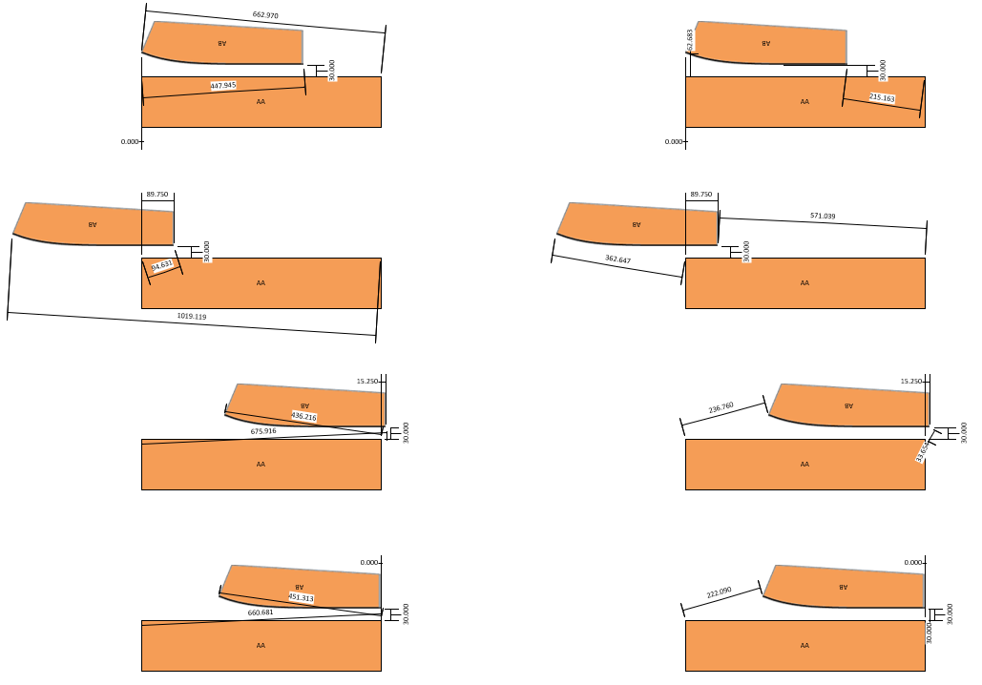
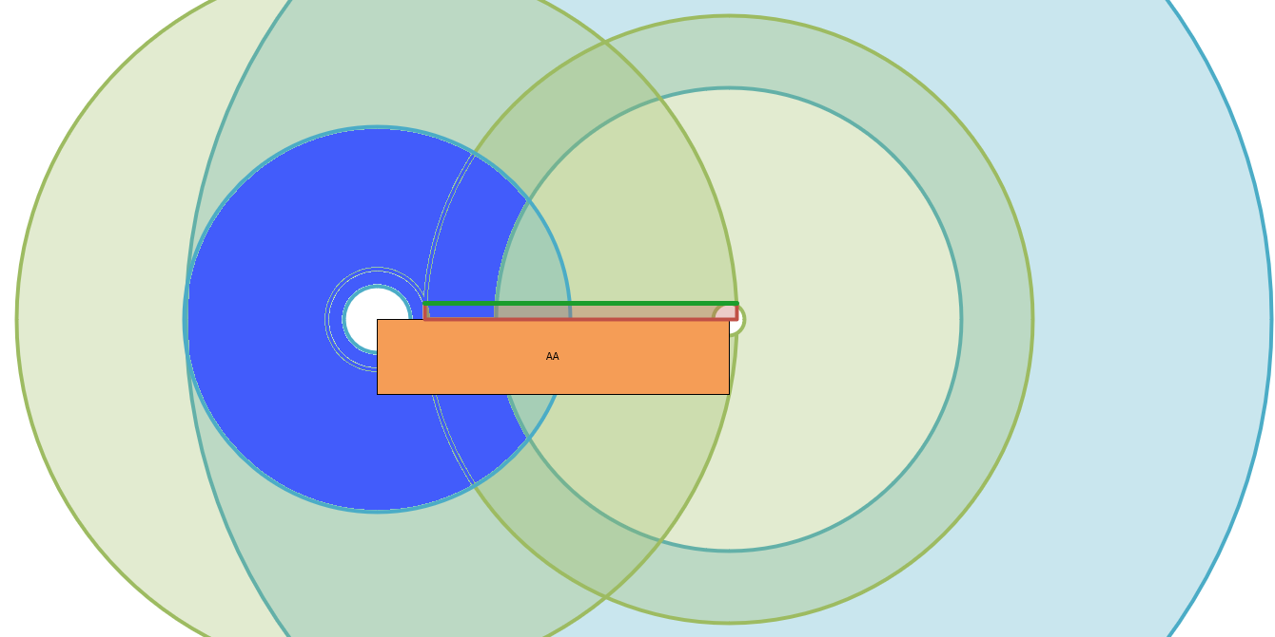
AA-AB Diverts
End 2
Start 2
Y
Maps and Rules
Start 1
End 1
X
Must overlap at least 90mm (+/-0.25mm) and be 30mm apart
Start 2 must be 94.631-675.916mm from Start 1 and 30-571.039mm from End 1
End 2 must be 62.683-362.647mm from Start 1 and 436.216-1019.119mm from End 1
Start 2 must be 30mm from the line formed by Start 1 and End 1

Slide 16
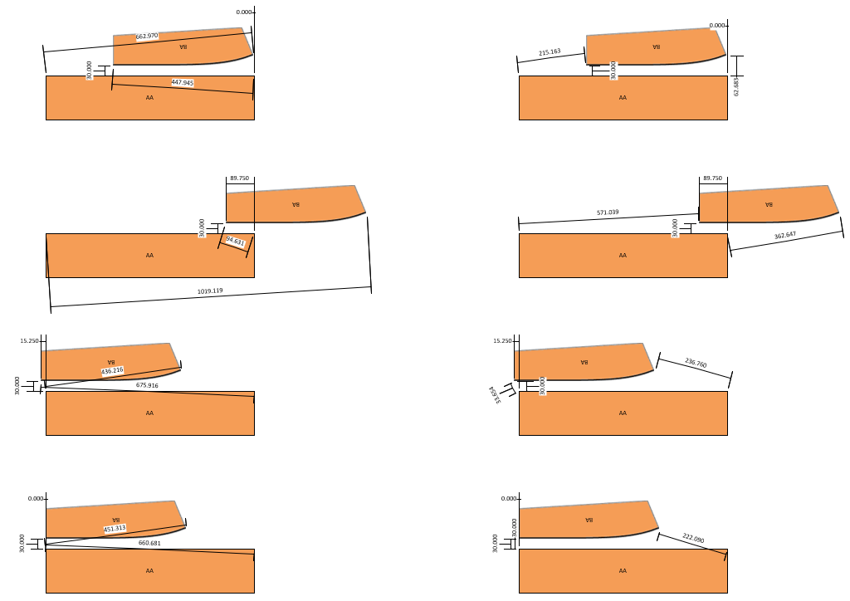
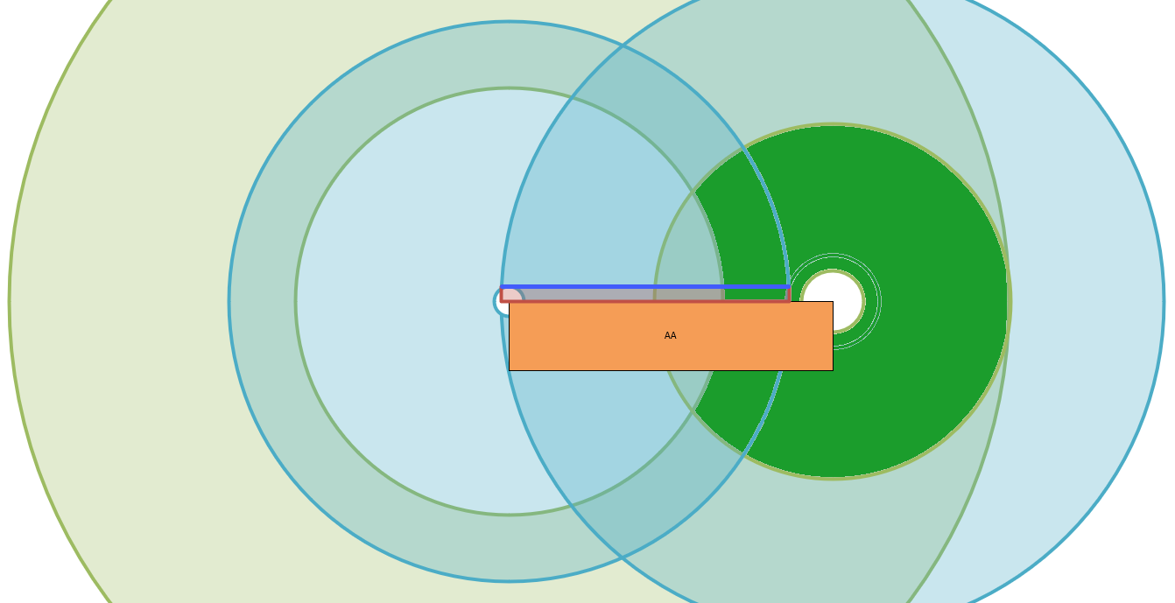
AA-BA Diverts
Start 2
End 2
Y
Maps and Rules
Start 1
End 1
X
Must overlap at least 90mm (+/-0.25mm) and be 30mm apart
Start 2 must be 436.216-1019.119mm from Start 1 and 62.683-362.647mm from End 1
End 2 must be 30-571.039mm from Start 1 and 94.631-675.916mm from End 1
End 2 must be 30mm from the line formed by Start 1 and End 1

Slide 17
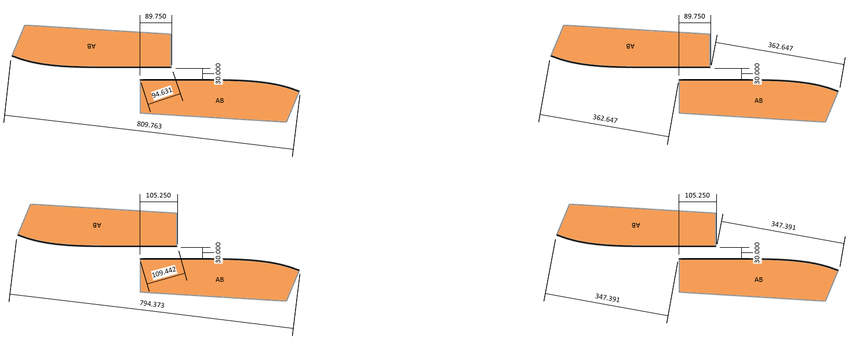
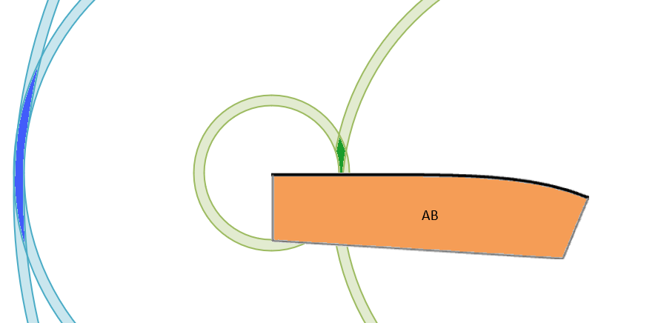
AB-AB Diverts
Start 2
Y
End 1
End 2
Maps and Rules
Start 1
X
Must be between 90-105mm overlap (+/-0.25mm) and 30mm apart
Start 2 must be 94.631-109.442mm from Start 1 and 347.391-362.647mm from End 1
End 2 must be 347.391-362.647mm from Start 1 and 794.373-809.763mm from End 1

Slide 18
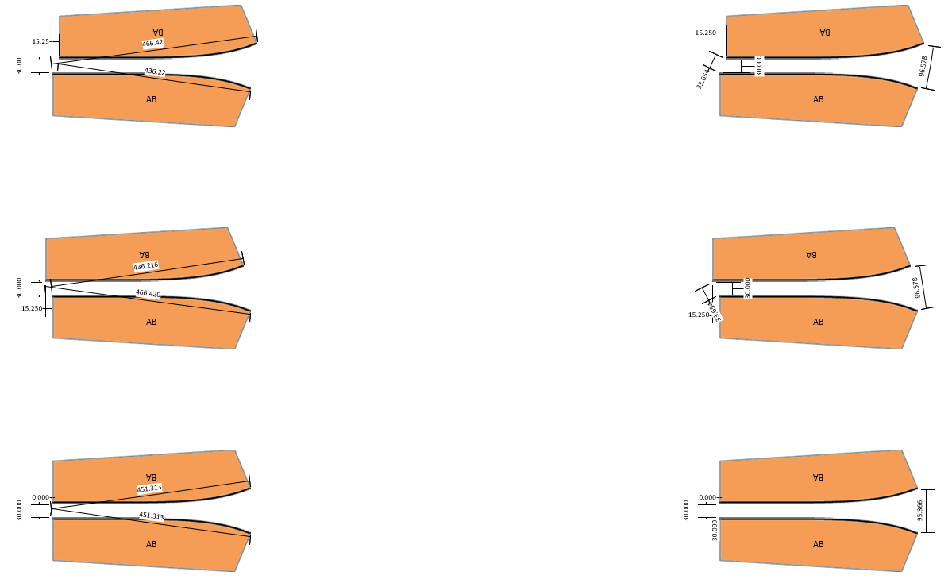
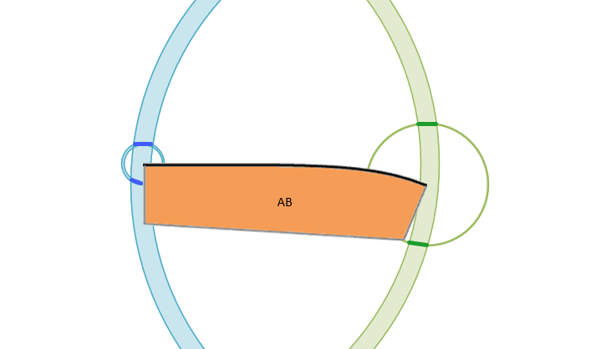
AB-BA Diverts
End 2
Start 2
Y
Maps and Rules
Start 1
End 1
X
Must be aligned at the gap +-15mm (+/-0.25mm) and 30mm apart
Start 2 must be 436.216-466.420mm from Start 1 and 95.366-96.578mm from End 1
End 2 must be 30-33.654mm from Start 1 and 436.216-466.420mm from End 1

Slide 19
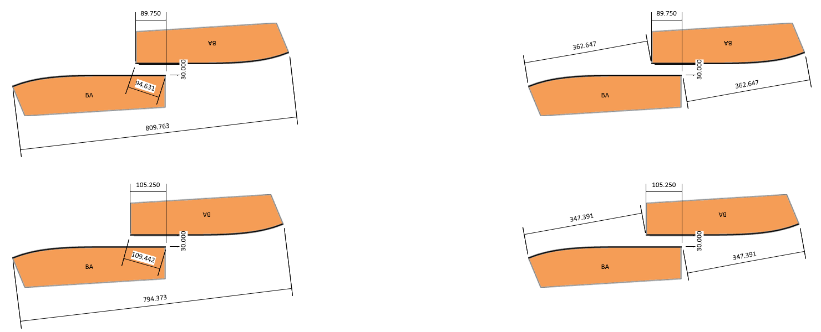
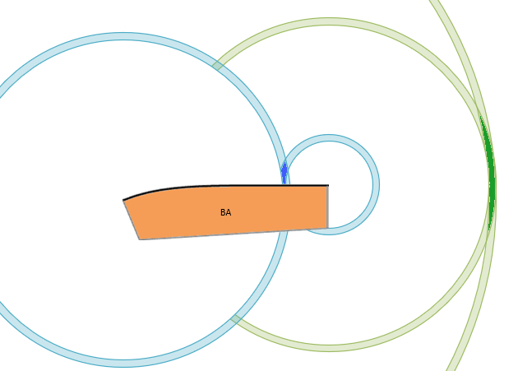
BA-BA Diverts
Start 1
End 2
Y
Start 2
Maps and Rules
End 1
X
Must be between 90-105mm overlap (+/-0.25mm) and 30mm apart
Start 2 must be 794.373-809.763mm from Start 1 and 347.391-362.647mm from End 1
End 2 must be 347.391-362.647mm from Start 1 and 94.631-109.442mm from End 1

Slide 20
Finding Good Measurement Spots
Where to Send the Shuttle

Slide 21
Assumptions
Finding Measurement Spots
The user will have created sectors so that every divert has at least one sector through it
Based on previous slides, all diverts are known
All diverts are configured with 30mm gaps

Slide 22
Step 1: Determine Overlap
Finding Measurement Spots
Measurement varies based on the divert pairing
AA – AA
AA – AB
AA – BA
AB – AB
AB – BA
BA - BA

Slide 23
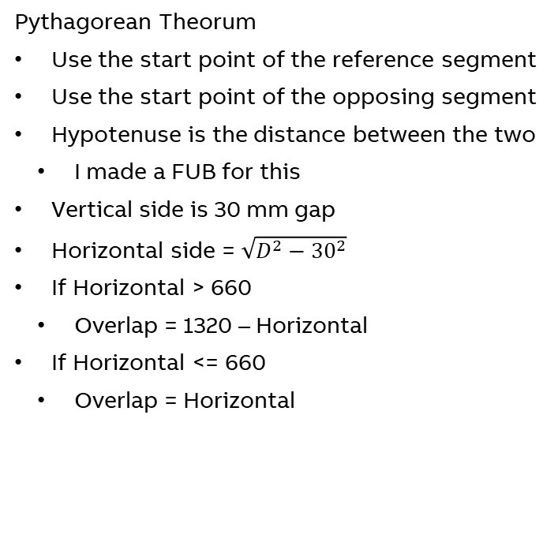
AA – AA
Step 1: Determine Overlap
Pythagorean Theorum
Use the start point of the reference segment
Use the start point of the opposing segment
Hypotenuse is the distance between the two
I made a FUB for this
Vertical side is 30 mm gap
Horizontal side = $\sqrt{D^{2}−{30}^{2}}$
If Horizontal > 660
Overlap = 1320 – Horizontal
If Horizontal <= 660
Overlap = Horizontal
D
30
30
D

Slide 24
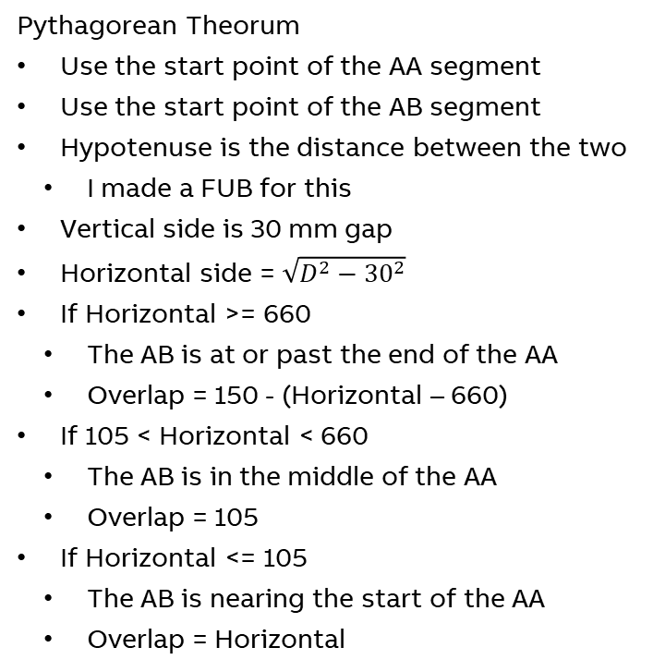
AA – AB
Step 1: Determine Overlap
D
30
Pythagorean Theorum
Use the start point of the AA segment
Use the start point of the AB segment
Hypotenuse is the distance between the two
I made a FUB for this
Vertical side is 30 mm gap
Horizontal side = $\sqrt{D^{2}−{30}^{2}}$
If Horizontal >= 660
The AB is at or past the end of the AA
Overlap = 150 - (Horizontal – 660)
If 105 < Horizontal < 660
The AB is in the middle of the AA
Overlap = 105
If Horizontal <= 105
The AB is nearing the start of the AA
Overlap = Horizontal
D
D
30
30
D
30

Slide 25
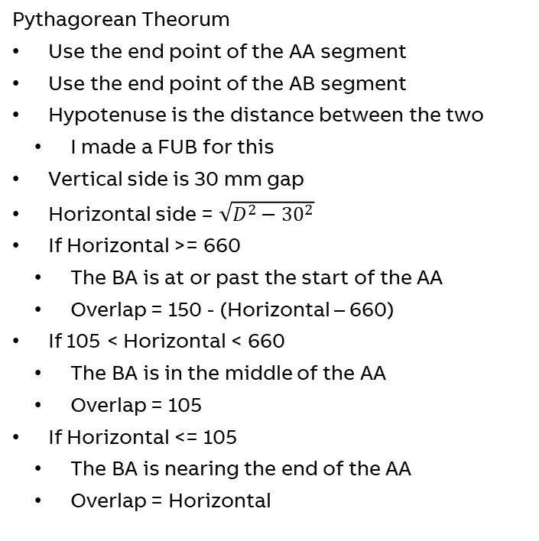
AA – BA
Step 1: Determine Overlap
30
D
Pythagorean Theorum
Use the end point of the AA segment
Use the end point of the AB segment
Hypotenuse is the distance between the two
I made a FUB for this
Vertical side is 30 mm gap
Horizontal side = $\sqrt{D^{2}−{30}^{2}}$
If Horizontal >= 660
The BA is at or past the start of the AA
Overlap = 150 - (Horizontal – 660)
If 105 < Horizontal < 660
The BA is in the middle of the AA
Overlap = 105
If Horizontal <= 105
The BA is nearing the end of the AA
Overlap = Horizontal
D
D
30
30
30
D

Slide 26
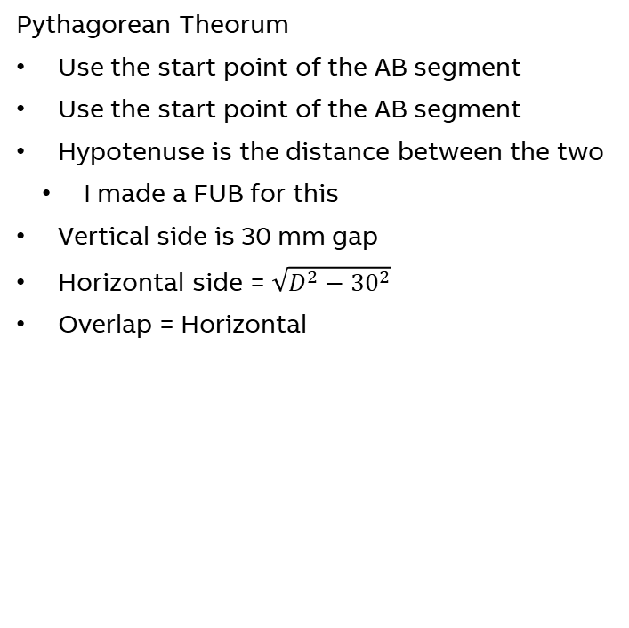
AB – AB
Step 1: Determine Overlap
Pythagorean Theorum
Use the start point of the AB segment
Use the start point of the AB segment
Hypotenuse is the distance between the two
I made a FUB for this
Vertical side is 30 mm gap
Horizontal side = $\sqrt{D^{2}−{30}^{2}}$
Overlap = Horizontal
D
30

Slide 27
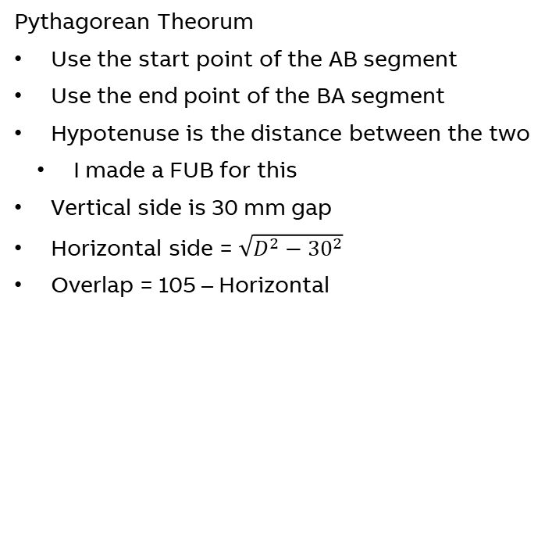
AB – BA
Step 1: Determine Overlap
D
30
Pythagorean Theorum
Use the start point of the AB segment
Use the end point of the BA segment
Hypotenuse is the distance between the two
I made a FUB for this
Vertical side is 30 mm gap
Horizontal side = $\sqrt{D^{2}−{30}^{2}}$
Overlap = 105 – Horizontal
D
30
D
30

Slide 28
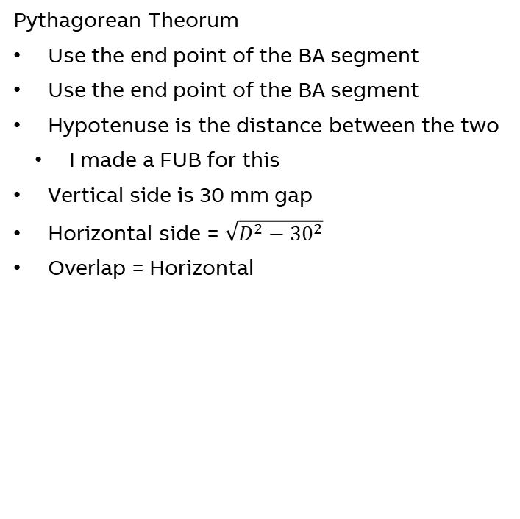
BA – BA
Step 1: Determine Overlap
Pythagorean Theorum
Use the end point of the BA segment
Use the end point of the BA segment
Hypotenuse is the distance between the two
I made a FUB for this
Vertical side is 30 mm gap
Horizontal side = $\sqrt{D^{2}−{30}^{2}}$
Overlap = Horizontal
30
D

Slide 29
Step 2: Determine Middle of Overlap
Finding Measurement Spots
Should be similar to the overlap calculation
Need a result with respect to each segment
i.e. pos x on segX and position y on segY

Slide 30
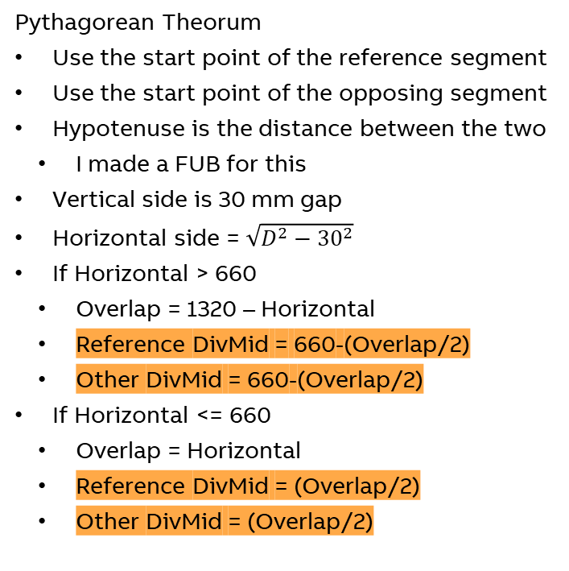
AA – AA
Step 2: Determine Middle of Overlap
Pythagorean Theorum
Use the start point of the reference segment
Use the start point of the opposing segment
Hypotenuse is the distance between the two
I made a FUB for this
Vertical side is 30 mm gap
Horizontal side = $\sqrt{D^{2}−{30}^{2}}$
If Horizontal > 660
Overlap = 1320 – Horizontal
Reference DivMid = 660-(Overlap/2)
Other DivMid = 660-(Overlap/2)
If Horizontal <= 660
Overlap = Horizontal
Reference DivMid = (Overlap/2)
Other DivMid = (Overlap/2)
D
30
30
D

Slide 31
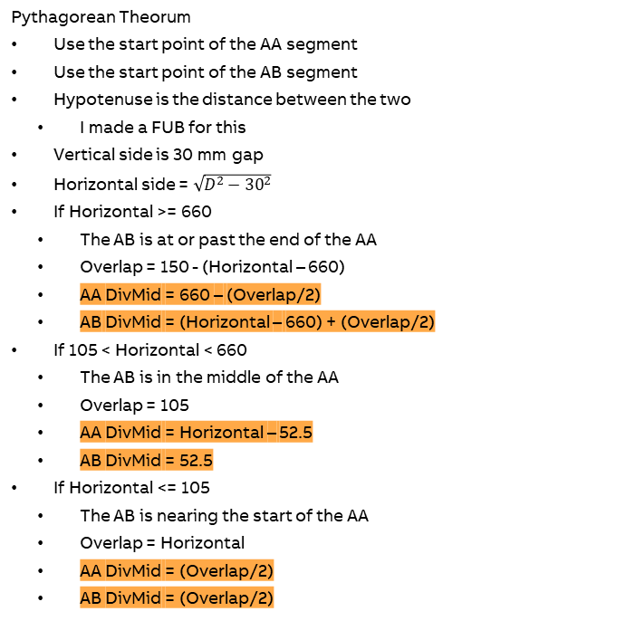
AA – AB
Step 2: Determine Middle of Overlap
D
30
Pythagorean Theorum
Use the start point of the AA segment
Use the start point of the AB segment
Hypotenuse is the distance between the two
I made a FUB for this
Vertical side is 30 mm gap
Horizontal side = $\sqrt{D^{2}−{30}^{2}}$
If Horizontal >= 660
The AB is at or past the end of the AA
Overlap = 150 - (Horizontal – 660)
AA DivMid = 660 – (Overlap/2)
AB DivMid = (Horizontal – 660) + (Overlap/2)
If 105 < Horizontal < 660
The AB is in the middle of the AA
Overlap = 105
AA DivMid = Horizontal – 52.5
AB DivMid = 52.5
If Horizontal <= 105
The AB is nearing the start of the AA
Overlap = Horizontal
AA DivMid = (Overlap/2)
AB DivMid = (Overlap/2)
D
D
30
30
D
30

Slide 32
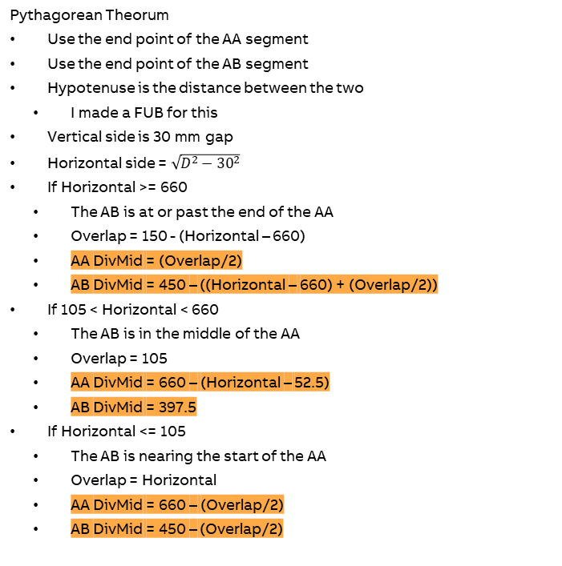
AA – BA
Step 2: Determine Middle of Overlap
30
D
Pythagorean Theorum
Use the end point of the AA segment
Use the end point of the AB segment
Hypotenuse is the distance between the two
I made a FUB for this
Vertical side is 30 mm gap
Horizontal side = $\sqrt{D^{2}−{30}^{2}}$
If Horizontal >= 660
The AB is at or past the end of the AA
Overlap = 150 - (Horizontal – 660)
AA DivMid = (Overlap/2)
AB DivMid = 450 – ((Horizontal – 660) + (Overlap/2))
If 105 < Horizontal < 660
The AB is in the middle of the AA
Overlap = 105
AA DivMid = 660 – (Horizontal – 52.5)
AB DivMid = 397.5
If Horizontal <= 105
The AB is nearing the start of the AA
Overlap = Horizontal
AA DivMid = 660 – (Overlap/2)
AB DivMid = 450 – (Overlap/2)
D
D
30
30
30
D

Slide 33
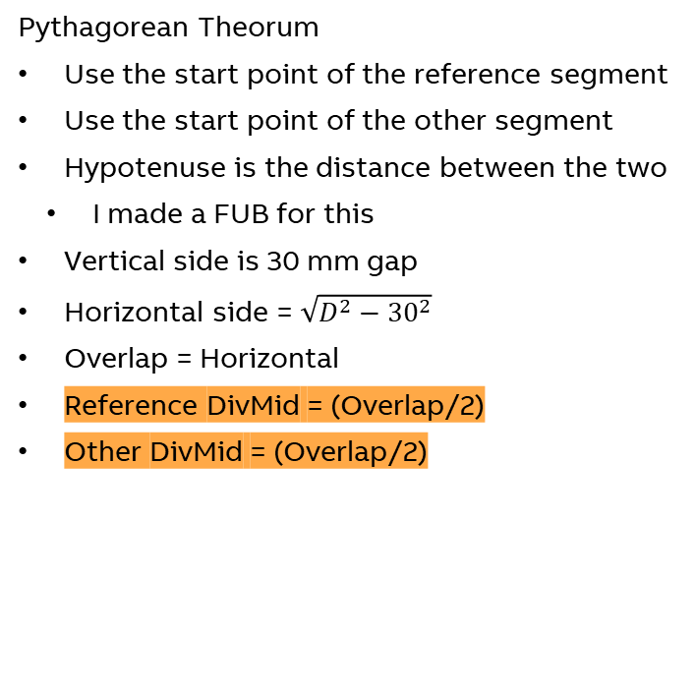
AB – AB
Step 2: Determine Middle of Overlap
Pythagorean Theorum
Use the start point of the reference segment
Use the start point of the other segment
Hypotenuse is the distance between the two
I made a FUB for this
Vertical side is 30 mm gap
Horizontal side = $\sqrt{D^{2}−{30}^{2}}$
Overlap = Horizontal
Reference DivMid = (Overlap/2)
Other DivMid = (Overlap/2)
D
30

Slide 34
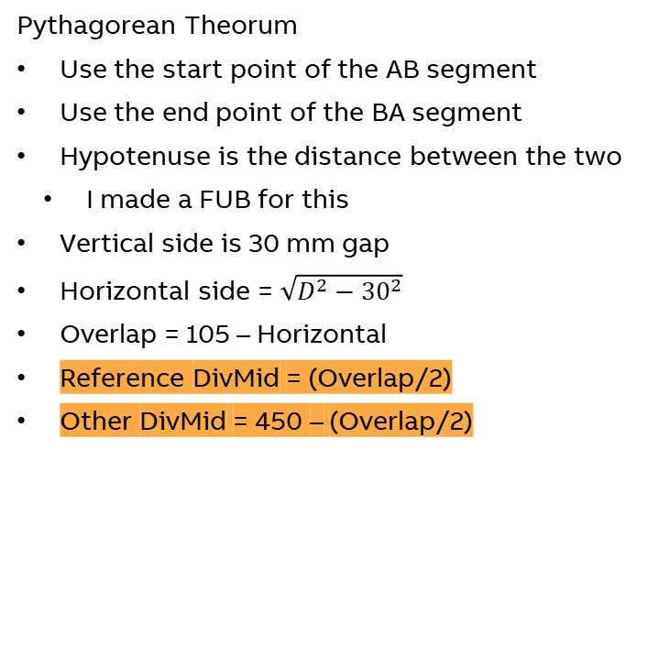
AB – BA
Step 2: Determine Middle of Overlap
D
30
Pythagorean Theorum
Use the start point of the AB segment
Use the end point of the BA segment
Hypotenuse is the distance between the two
I made a FUB for this
Vertical side is 30 mm gap
Horizontal side = $\sqrt{D^{2}−{30}^{2}}$
Overlap = 105 – Horizontal
Reference DivMid = (Overlap/2)
Other DivMid = 450 – (Overlap/2)
D
30
D
30

Slide 35
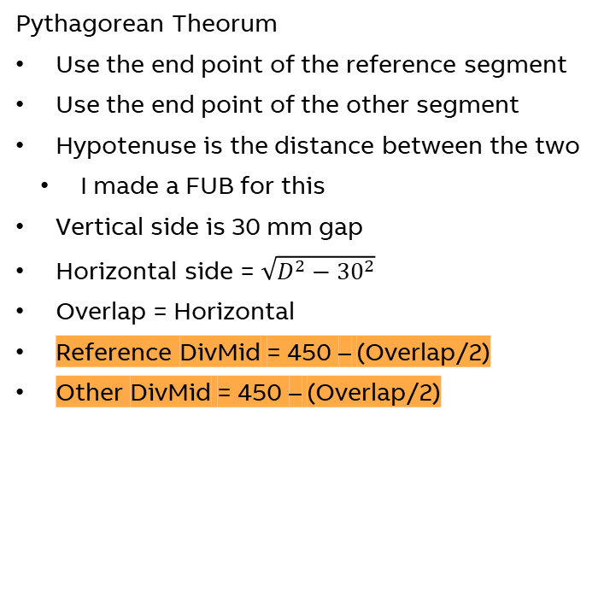
BA – BA
Step 2: Determine Middle of Overlap
Pythagorean Theorum
Use the end point of the reference segment
Use the end point of the other segment
Hypotenuse is the distance between the two
I made a FUB for this
Vertical side is 30 mm gap
Horizontal side = $\sqrt{D^{2}−{30}^{2}}$
Overlap = Horizontal
Reference DivMid = 450 – (Overlap/2)
Other DivMid = 450 – (Overlap/2)
30
D

Slide 36
Step 3: Determine Center of Divert
Displaying in Paper
We know the start points and angles, end points and angles, overlap lengths, and midpoints of overlaps on segments.

Slide 37
Reminder of Coordinate System
180
202.5
-180
22.5
135
Function Blocks
225
135
45
To make them all in the same useful coordinate system:
Angle 1 is 0 and angle 2 is 180
Transform by taking absolute value
Angle 1 is 0 and angle 2 is -180
Transform by +360
Angle 1 is 180 and angle 2 is 0
Transform by +180
67.5
247.5
90
90
-90
270
45
-45
45
315
0
0

Slide 38
AA – AA
Step 3: Determine Center of Divert
Base it on the reference segment
In the trak coordinate system, 0 degrees rotation is down
Overlap is known (relative to the start point)
For BA, subtract 450 to make it relative to end point
Center of divert is 15mm from midpoint
Makes a right angle with the overlap
Without rotation
AA & AB
X is startX – Overlap
Y is startY – 15mm
BA
X is startX + Overlap
Y is startY – 15mm

Slide 39
AA – AA
Step 3: Determine Center of Divert
Most segments will be rotate by some angle
In SVGs, you can create a rectangle with the following parameters
X
Coordinate of the top left corner
AA & AB: StartX – Midpoint – (Overlap/2)
BA: EndX + (450 – midpoint) – (Overlap/2)
Y
Coordinate of the top left corner
AA & AB: StartY
BA: EndY
Width
Overlap
Height
30mm

Slide 40
AA – AA
Step 3: Determine Center of Divert
Most segments will be rotate by some angle
In SVGs, you can rotate shapes by an angle about the point X,Y
Angle
Calculated as described a few slides ago
X
AA & AB: StartX
BA: EndX
Y
AA & AB: StartY
BA: EndY

Slide 41
Output to the User
What they need to know

Slide 42
What we already have
Output to the user
Divert Info
Midpoint of the overlap for each segment
A shuttle in the divert within some distance of the midpoint
ShReadSeg
Outputs the shuttle’s actual position on each segment
The difference between the respective midpoints and positions can be calculated
Shown in red
If the segments are perfectly aligned, then the difference between these is zero
If the segments are offset, the difference is nonzero

Slide 43
Interpreting the values
Output to the user
Difference between offsets
A difference of zero mean the segments are aligned in real life exactly as they are defined in the assembly config
A non-zero difference means the segments are slightly off from the alignment defined in the assembly config

Slide 44
Interpreting the values
Output to the user
SEG_2
Dy
Example
The divert midpoint on SEG_1 is at position X
The offset of the shuttle position on SEG_1 from X is Dx
The divert midpoint on SEG_2 is at position Y
The offset of the shuttle position on SEG_2 from Y is Dy
The absolute value of the difference is the alignment error, E
|Dx – Dy| = E
Y
E
X
Dx
SEG_1

Slide 45
Interpreting the values
Output to the user
SEG_2
Dy
Example
The assembly config says
A position on SEG_1 aligns with a position on SEG_2
Two options (user must decide)
Y
E
X
Dx
SEG_1

